Slide 1
Dealing with Difficult People
Believe it or not, you can stay calm, defuse conflict, and keep your dignity.

Slide 2
Workshop overview
In the ideal world , difficult behaviors would not be tolerated at work,
in reality …
dealing with difficult people is something many people face as part of their
everyday lives .

Slide 3
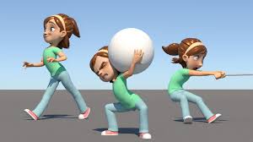
Course overview
Through this interactive workshop
and practice exercises ,
you will learn how to deal with
a wide range of challenging situations ,
not only in workplace but also through
the rest of your daily life.

Slide 4
Workshop overview
Without the command of solid coping mechanisms, the STRESS of handling difficult people and tough situations can create poor attitude , lack of productivity and reluctance to go to work.

Slide 5
How often you deal with difficult people?
Whom you consider a difficult person and you hate to deal with ?
Sometimes it doesn’t matter how hard you try to get away ..they find you !

Slide 6
Who

Slide 7
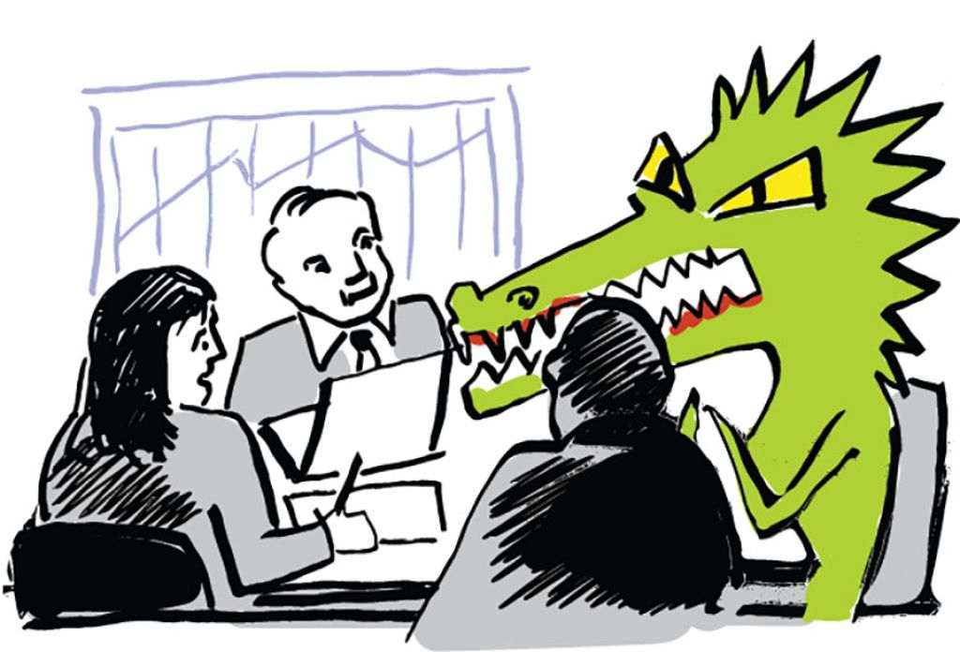
Difficult people whom you know ..
Complainers
Time stealer
Gossips spreaders
Emotional Vampires
The “ Know it all “
Others who make interactions challenging

Slide 8
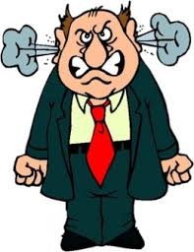
If you do not know how to handle these characters , they can have a negative influence on you and your day….
Does anyone want that to happen ??

Slide 9
We... Edge , we don’t think so !

Slide 10
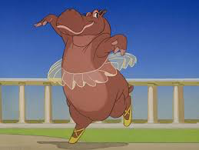
Discover how to shake off the effect of
difficult people and “dance “
through tough interactions

Slide 11
During this workshop you will learn:
1- What causes people to be difficult ?.
2- The value of a positive mindset.
3- Tactics and skills to handle the .
challenging situations.
4- Tips for staying resilient during
challenging situations .
5- Ideas for managing stress .

